Slide 1
Agenda
Start | End | Item
 |  | East Side Vs West Side of Cleveland!
 |  | Absenteeism KNN example

Slide 2
KNN

Slide 3
Now a new Classification Approach - KNN
Characteristics of KNN
Data-driven, not heuristics (rules) based
No parameters, beta coefficients, means time to predict or classify can be lengthy because each new record is scored against the existing training set.
Makes no assumptions about the data e.g. outliers, non-normal distributions – all are accepted

Slide 4
Basic Idea
For a given record to be classified, identify nearby records
“Near” means records with similar predictor values X₁, X₂, … X_{p}
Classify the record as whatever the predominant class is among the nearby records (the “neighbors”)
Your brain makes similar associative leaps…the upcoming example proves it!

Slide 5
How to measure “nearby”?
The most popular distance measure is Euclidean distance
DON’T WORRY ABOUT THIS
R will handle it!
Typically, predictor variables are first normalized (= standardized) to put them on comparable scales
An easy and consistent method for normalization is to use preProcess() from caret but can also be done with scale()
Without normalization, metrics with large scales dominate

Slide 6
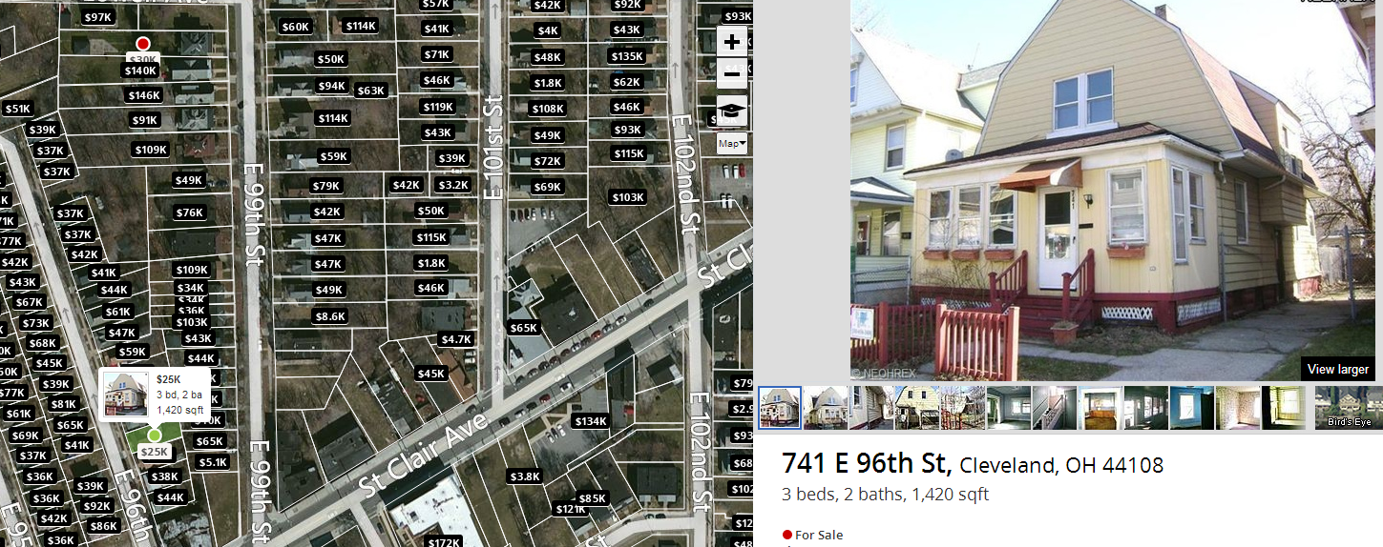
East Side of Cleveland on Zillow

Slide 7
Example East Side House
$25K
3 beds
2 baths
1,420 sqft
44108 zip

Slide 8
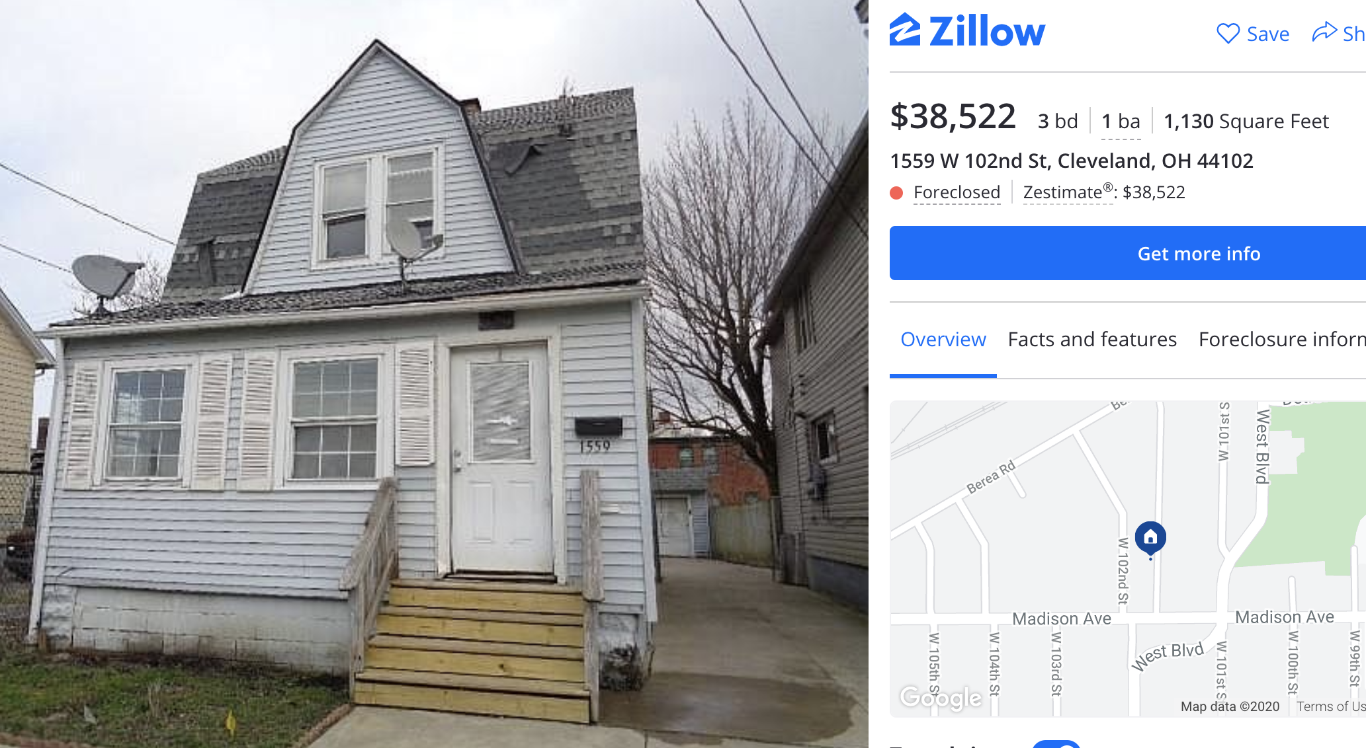
Example West Side House

Slide 9
Collected a small data set comparing East Cleveland to West.
West Cleveland
East Cleveland
Beds | Bath | SqFt | Price
4 | 4.5 | 4110 | 1.175M
5 | 1.75 | 1616 | $155K
4 | 2 | 1480 | $64K
4 | 4 | 2640 | $279K
5 | 5 | 4175 | $525K
5 | 2.5 | 1702 | $120K
3 | 1 | 1582 | $103K
3 | 2 | 1292 | $100K
3 | 3 | 1780 | $159K
Beds | Bath | SqFt | Price
3 | 1 | 1181 | $65K
3 | 1.5 | 1391 | $39K
4 | 1 | 1424 | $39K
4 | 2 | 1895 | $30K
5 | 1 | 1607 | $50K
4 | 1 | 1312 | $11K
3 | 1 | 1152 | $5K
4 | 1 | 1556 | $81K
2 | 1 | 811 | $46K
What patterns do we observe in this data?

Slide 10

Here are some unknown houses…
East Side or West Side?
Beds | Bath | SqFt | Price
5 | 1.5 | 1136 | $48K
6 | 3 | 4500 | $259K
3 | 1.5 | 1300 | $85K
3 | 2 | 1300 | $106K
2 | 2 | 1170 | $200K
5 | 2 | 2592 | $95K
3 | 1 | 1398 | $100K
3 | 2 | 1300 | $106K
3 | 1.5 | 1614 | $124K

Slide 11
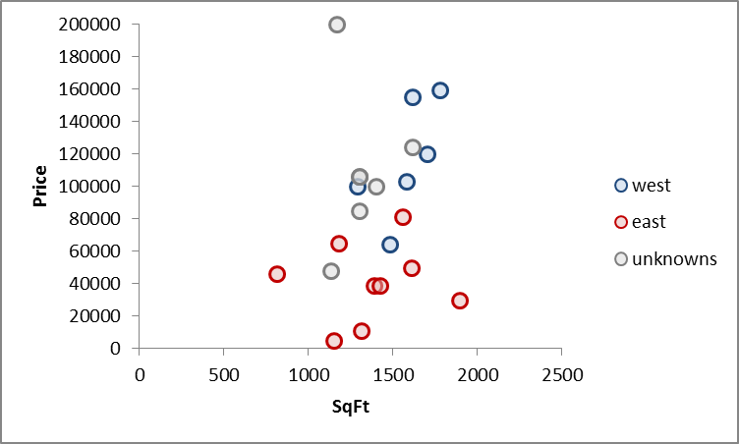
Let’s pick two house attributes, sqft and price
Plot East, West and Unknown houses on a scatter

Slide 12
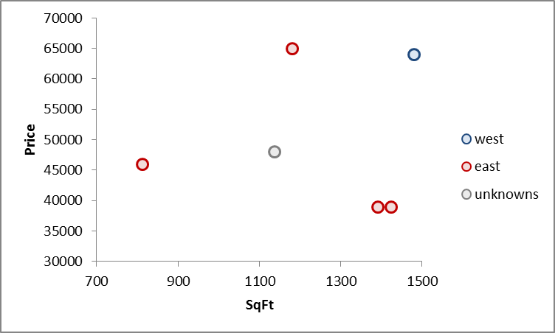
KNN Measures the Euclidean distance between points
Lets zoom in to a specific point
Without knowing distances or making calculations:
What side of the city do you think the unknown is?

Slide 13
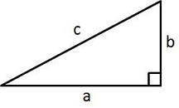
Euclidean Distance measures distance like a ruler
Remember Pythagorean Theorem?
In our example…
A²+B²=C²
b
c
a

Slide 14
Euclidean Distance measures distance like a ruler
In our example…
Define the segment values
EastSidePt = (1391sqft, $39K)
UnknownPt = (1136sqft,$48K)
aSegment = 1391-1136 = 255sqft
bSegment = $39k-$48k = $-9k
b
c
-9k
255
a

Slide 15
Euclidean Distance measures distance like a ruler
In our example…
Math time…
EastSidePt = (1391sqft, $39K)
UnknownPt = (1136sqft,$48K)
aSegment = 1391-1136 = 255sqft
bSegment = $39k-$48k = $-9k
c
A² + B² = C²
b
a
$-9000² + 255² = c ²
$81,000,000 + 65025 = c ²
$81,065,025= c ²
Sqrt($81,065,025)= c
9003 = c
The distance between the unknown and the closest East side point is 9003*.
We didn’t normalize (put all attributes on the same scale) so you can see that large impact price has on the distance moving from 9000 to 9003 but that’s not the point…this is just to show you a distance calc.

Slide 16
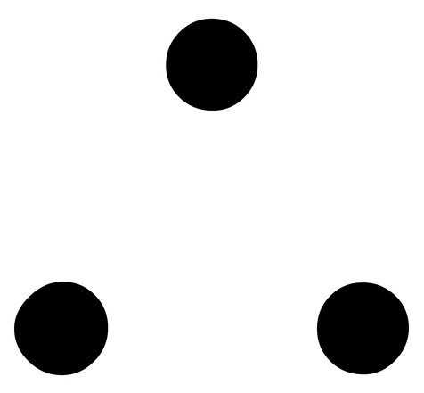
Euclidean Distance measures distance like a ruler
Remember Pythagorean Theorem?
In our example…
A²+B²=C²
c
b
a
West Side (1480sqft, $64K)
Unknown (1136sqft, $48K)
Distance
or C = 16003
Differences (45sqft, $17K)
b
a

Slide 17
Your guess K=1
16003
9003
With K = 1, the single nearest neighbor, what is the class? What about k=2? K=3?

Slide 18
K = 1
This unknown case is in…
In our example…
East Cleveland
5 Beds
1.5 Bath
1136 sqft
$48K
16003
9003
The KNN algorithm would have correctly identified East Cleveland if K = 1. Remember the algorithm performs this along more than 2 dimensions, in hyperspace.

Slide 19
K is a tuning parameter the practitioner chooses.
You will have to specify how many neighbors are to be looked at.
In our example…
Measured in hyperspace (many attributes not just 2)
Ties are randomly chosen for even number K but can be avoided using odd number K.
Returned results can be either the class (east or west) or the probability of a particular class.
17000
16003
9003
*scale is misleading because of attributes order of magnitude
Remember to normalize!
K=1 of only these 2 variables would say it is East Cleveland with a 100% certainty.
K=3 of only these 2 variables would say it is East Cleveland with a 66% probability.
Review confusion table to get to an acceptable K.

Slide 20



K is a tuning parameter the practitioner chooses.
Nearest Neighbor
K = 1
17000
16003
1 Red Neighbor / k =1 = 100% red
9003
K = 3
*scale is misleading because of attributes order of magnitude
Remember to normalize!
2 Red Neighbor / k =3 = 66% red

Slide 21


Is the “?” house a big house or a small house?
?
Perhaps more so than other methods, tuning your KNN is of the utmost importance.

Slide 22

Special K = 1!
K=1
?
K | Big House | Lil House | Guess | Actual | Notes
1 | 1 | 0 | Big House |  | Local Structure
Too localized!

Slide 23

Special K!
K=5
?
K | Big House | Lil House | Guess | Actual | Notes
1 | 1 | 0 | Big House |  | Local Structure
5 | 1 | 4 | Lil House |  | Just right
Just right for the data!

Slide 24
Special K!
K=10
?
K | Big House | Lil House | Guess | Actual | Notes
1 | 1 | 0 | Big House |  | Local Structure
5 | 1 | 4 | Lil House |  | Just right
10 | 6 | 4 | Big House |  | Majority Structure
Majority characteristic

Slide 25
Choosing k
K is the number of nearby neighbors to be used to classify the new record
K=1 means use the single nearest record
K=5 means use the 5 nearest records all have a “vote”
Typically choose that value of k which has lowest error rate in validation data
Use odd numbers to avoid ties
Let’s predict the probability of “Class A”
K= | Possible Outcomes
1 | Nearest neighbor is class A so 100% therefore class B probability is 0%
2 | Nearest 2 neighbors agree class A so 100%, or all neighbors are class B so 0% or neighbors are split so outcome is 50%
3 | Nearest 3 neighbors agree class A so 100%, or all neighbors are class B so 0%, or they split 33% or 66%. With a cutoff of 50% you can still make a classification.
4 | Nearest 4 neighbors agree class A so 100%, all neighbors are class B so 0%, or they split 25%, 50% or 75%. Cases of 50% probability are troublesome to determine same as K = 2.

Slide 26
Scaling your Inputs
Data measured in 1000s
Data measured in 100s
KNN measures distance but doesn’t know the scale of your inputs…house size in square centimeters will have larger quantities than house size measured in square miles. KNN will think the distance between CM is large!

Slide 27

Open normalization example.R
VTREAT will NOT scale your data!!
This script will show you how R “scales” and “centers” data to be on the same magnitude. We did it as part of the preprocessing lesson.

Slide 28
Agenda
Start | End | Item
 |  | East Side Vs West Side!
 |  | Absenteeism KNN example

Slide 29

Classifying Absenteeism at Work
Business Context:
Workers that are absent are costly to businesses.
In the US absenteeism is estimated to cost $225.8B or $1685 per employee EACH YEAR*
Understanding absenteeism reasons could lead employers to offer new benefits (like in office medical services, hand sanitizers) to reduce absenteeism while also improving the employee experience.
Dataset Source and Info:
http://archive.ics.uci.edu/ml/datasets/Absenteeism+at+work
The database was created with records of absenteeism at work from July 2007 to July 2010 at a courier company in Brazil.
740 Rows * 21 Attributes
HR wants you to classify absenteeism to help with employee support.
“What is the probability the absent employee is out because of “dental consultation” or “medical consolation”?
https://www.cdcfoundation.org/pr/2015/worker-illness-and-injury-costs-us-employers-225-billion-annually

Slide 30

Open B_knn_example_classification.R
When someone calls in the operator lists a reason for the absence.
Reason.for.absence
lowFreq :272
reason_0 : 43
reason_13: 55
reason_19: 40
We will build a KNN model classifying the reasons employees have been absent. A model like this can help classify new absent employees so we can learn what to offer to mitigate absenteeism costs and not ask employees directly.

Slide 31
Using K-NN for Prediction (Continuous)
Instead of “majority vote determines class” use average of response values
May be a weighted average, weight decreasing with distance
KNN has drawbacks but can be used for both prediction and classification so it demonstrates flexibility in that regard.

Slide 32
KNN is helpful for both business problems.
Class & Probability
K = 1
1 Red Neighbor / k =1 = 100% red
K = 3
2 Red Neighbor / k =3 = 66% red

Slide 33
KNN is helpful for both business problems.
Classification
Prediction
K = 1
K = 1
10hrs
1 Red Neighbor / k =1 = 100% red
Average of k =1 neighbor = 10
5hrs
K = 3
K = 3
1hrs
9hrs
2 Red Neighbor / k =3 = 66% red
Average of k =3 neighbors
= (9+5+1) / 3 = 5hrs

Slide 34

Open ﻿C_knn_example_prediction.R
Historical human resource records show the amount of time called out.
Absenteeism.time.in.hours
Min: 0
1st Qu.: 2
Median: 3
Mean: 6.92
3rd Qu.: 8
Max: 120
Now Operations wants to know the time employees will be away to improve staffing.
“If employee A is out given some characteristics, how much time will they miss and should we call a temp to work”

Slide 35
KNN Summary
Simple concept, useful for classification & prediction
Classification – majority class of nearest neighbors wins
Prediction – average value among nearest neighbors
Find distance between known and unknown records
“Curse of dimensionality” – need to limit # of predictors
Slow to predict new records –
non-parametric i.e. for every new record it must measure the distance to all data points in the training set, so the model object must also contain all of the original data. In contrast a parametric model like linear regression only retains the beta coefficients so its much faster.

Slide 36


Your Data Mining Toolbox
Previous Lessons
Some R Programming (R-studio)
EDA (summaries, column and row exploration)
Knowledge of Data Preparation (vtreat)
Basic Visualization (plot, ggplot)
Regression (continuous predictions)
Binary Classification (logistic regression)
Today
KNN (continuous & classification – binary or multi)
Decision Trees (continuous & classification – binary or multi
The KNN algo is a real machine learning algorithm which can solve binary classification, multi-classification & continuous problems!

